Slide 1
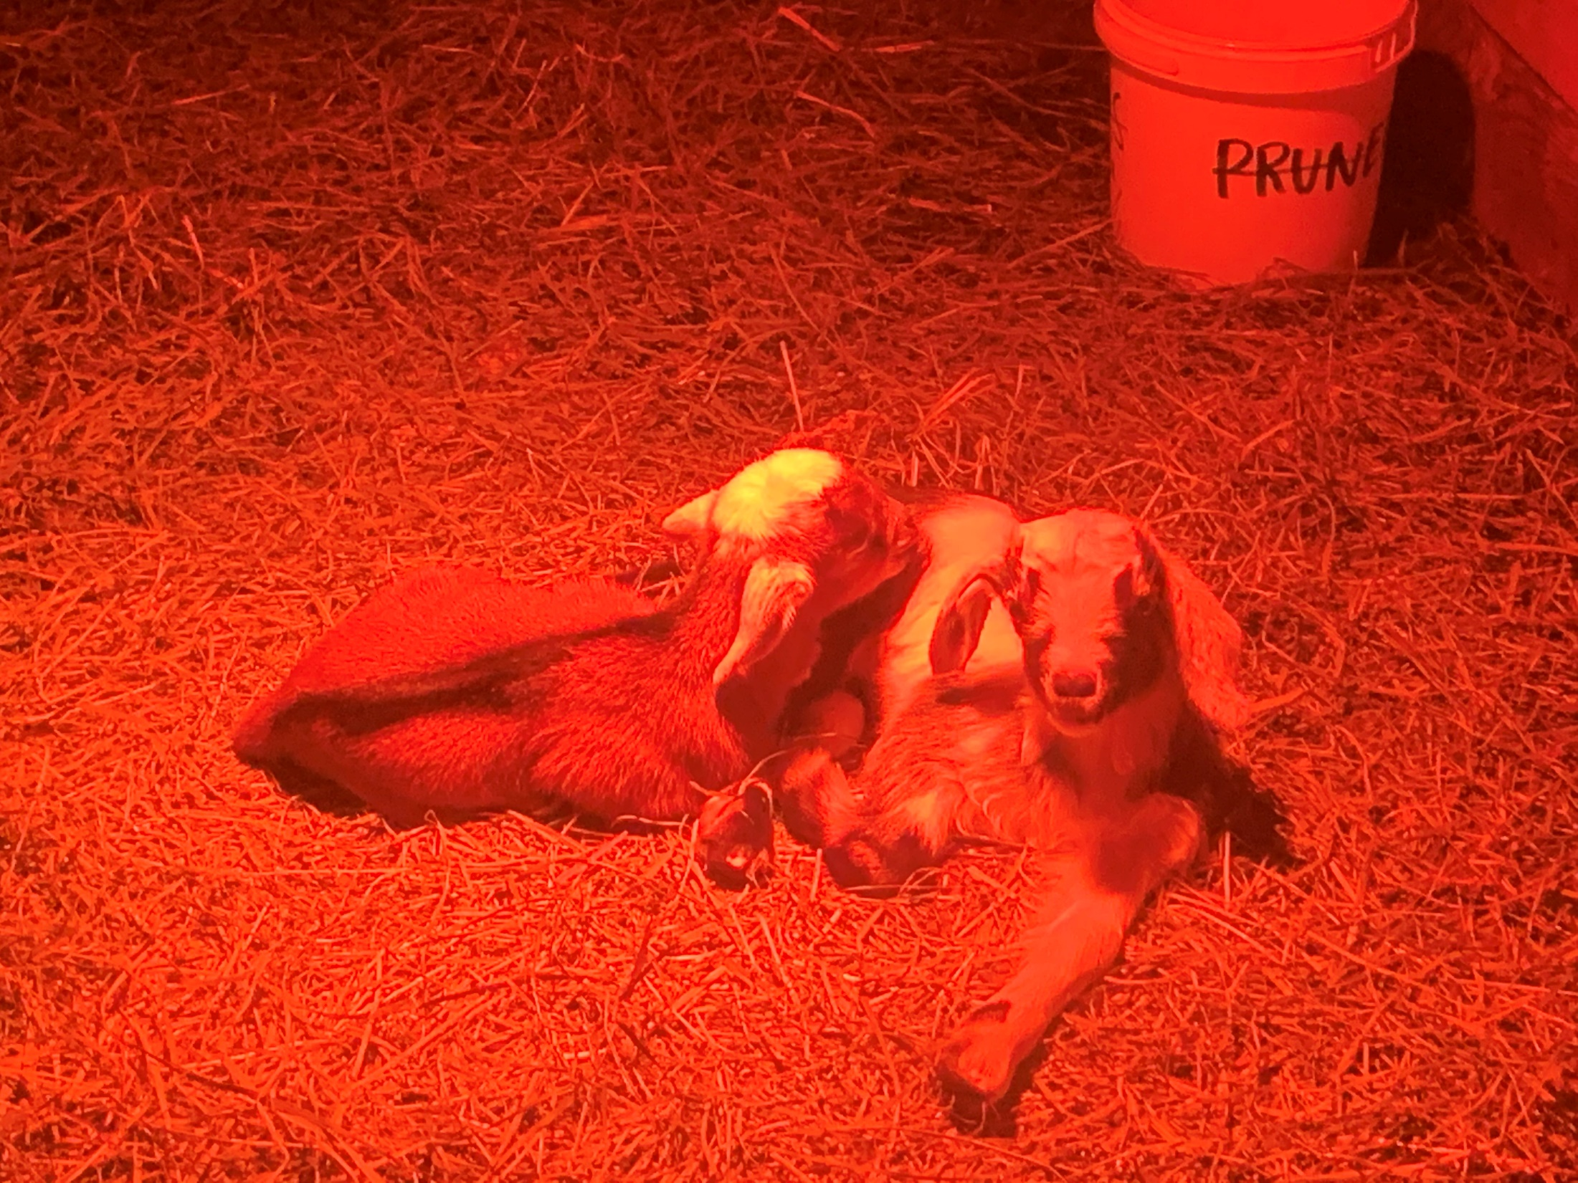
Thank you Carisbrooke and Blueridge for such a great experience ☺

Slide 2
Cabin #1

Slide 3
Cabin #2

Slide 4
Cabin #3

Slide 5
Cabin #4

Slide 6
Cabin #5

Slide 7
Cabin #6

Slide 8
Cabin #7

Slide 9
Cabin #8

Slide 11
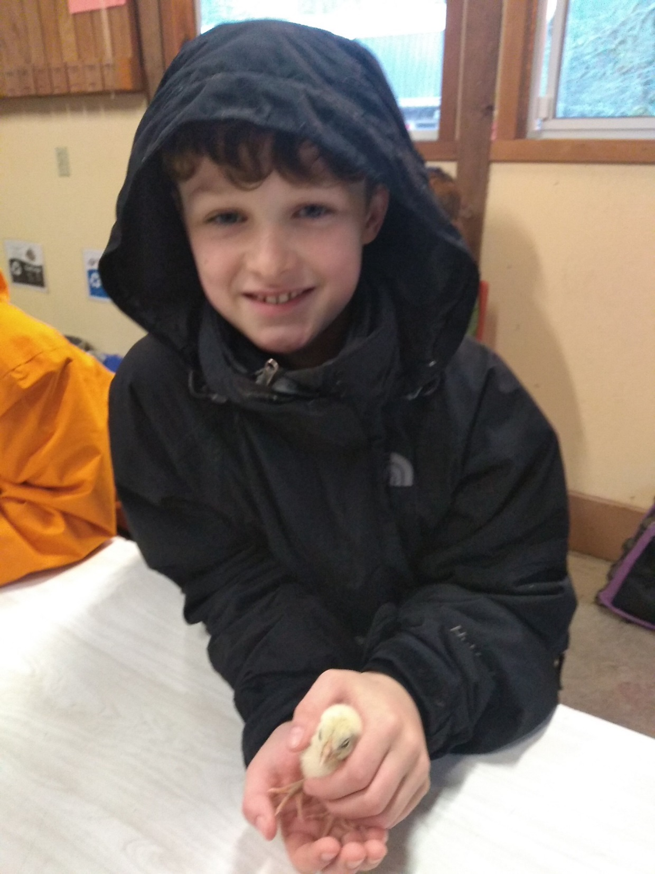

Slide 15
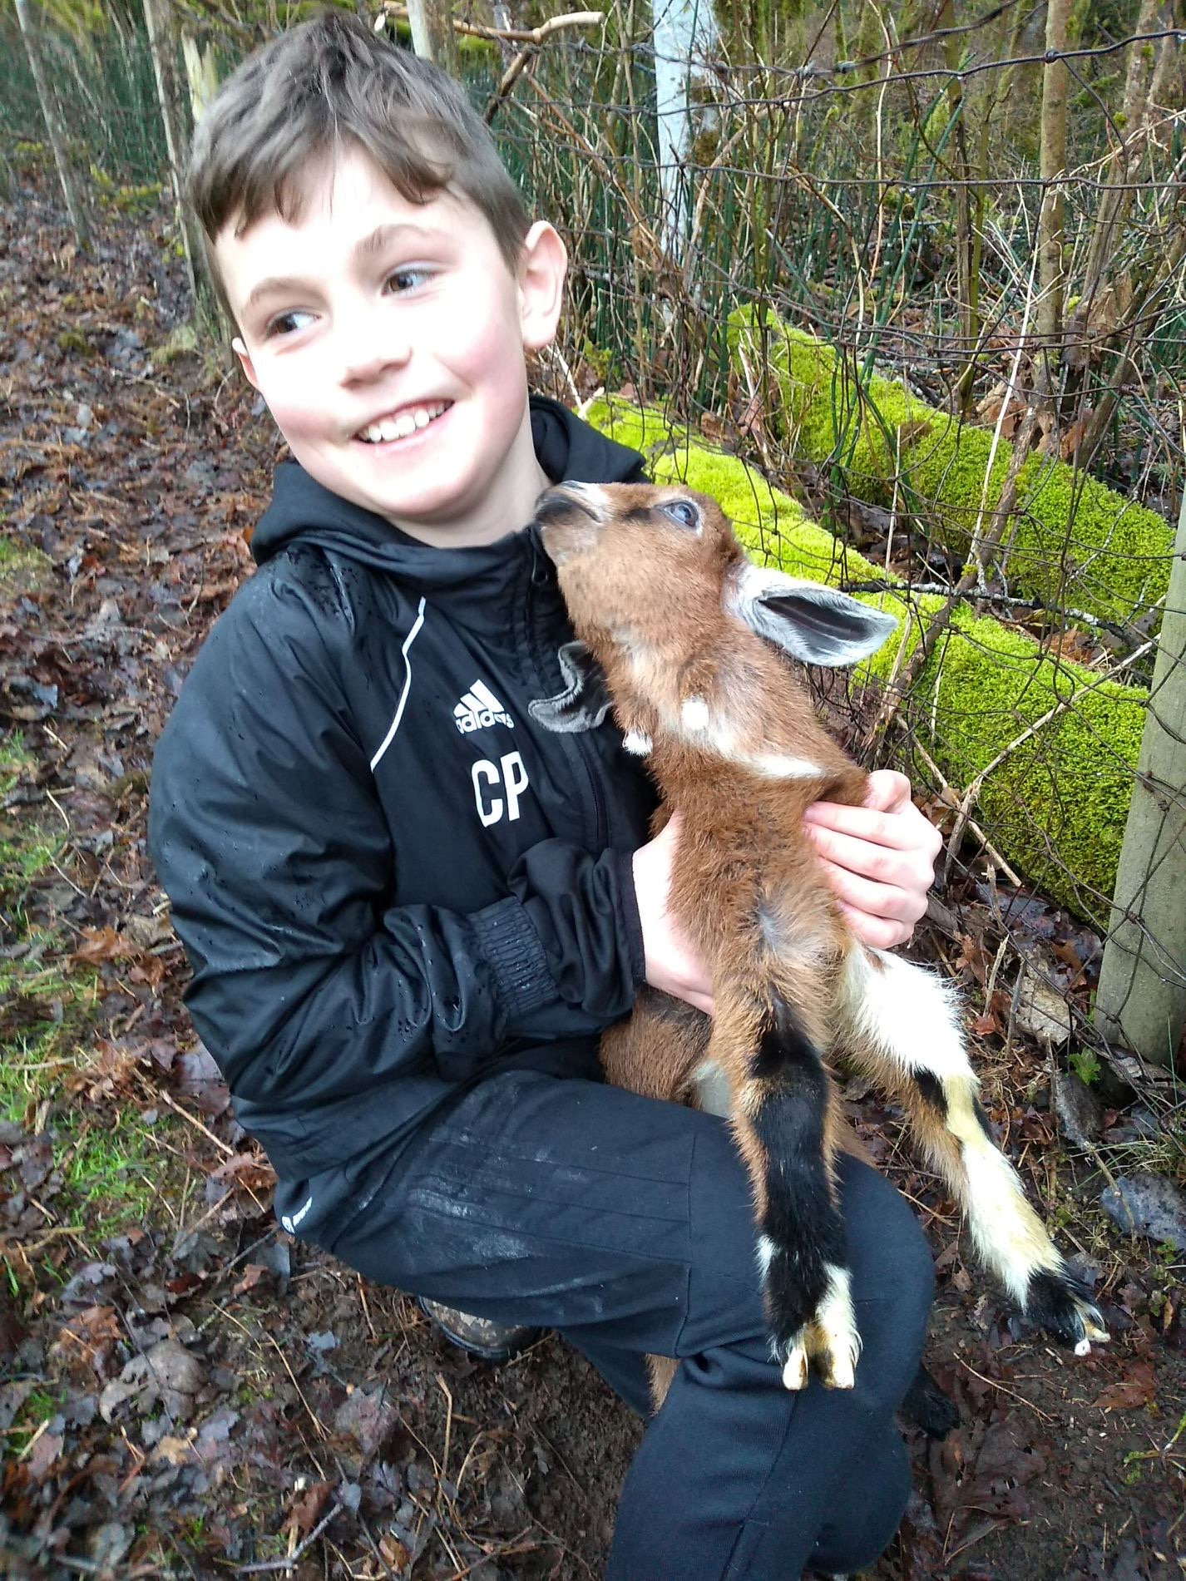

Slide 19
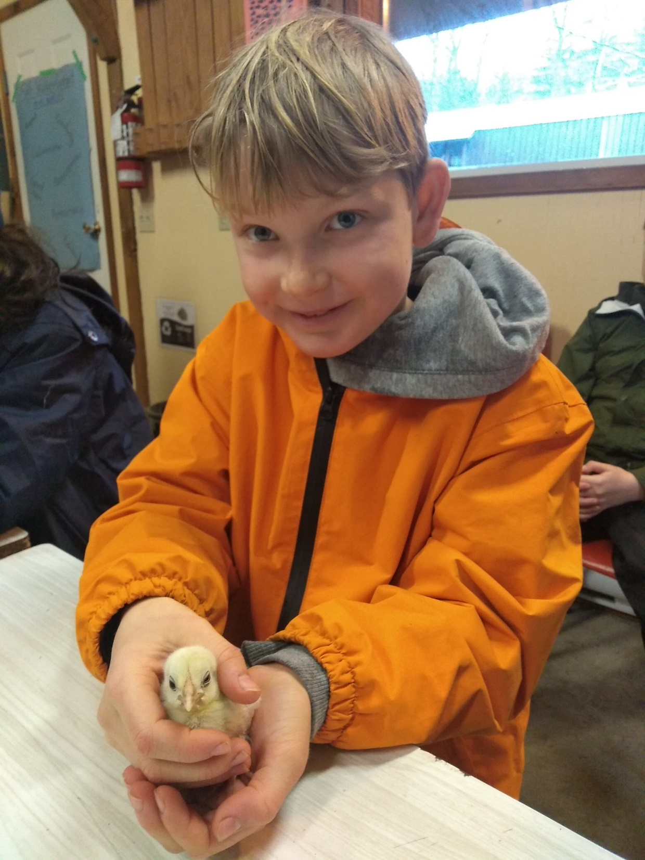

Slide 22
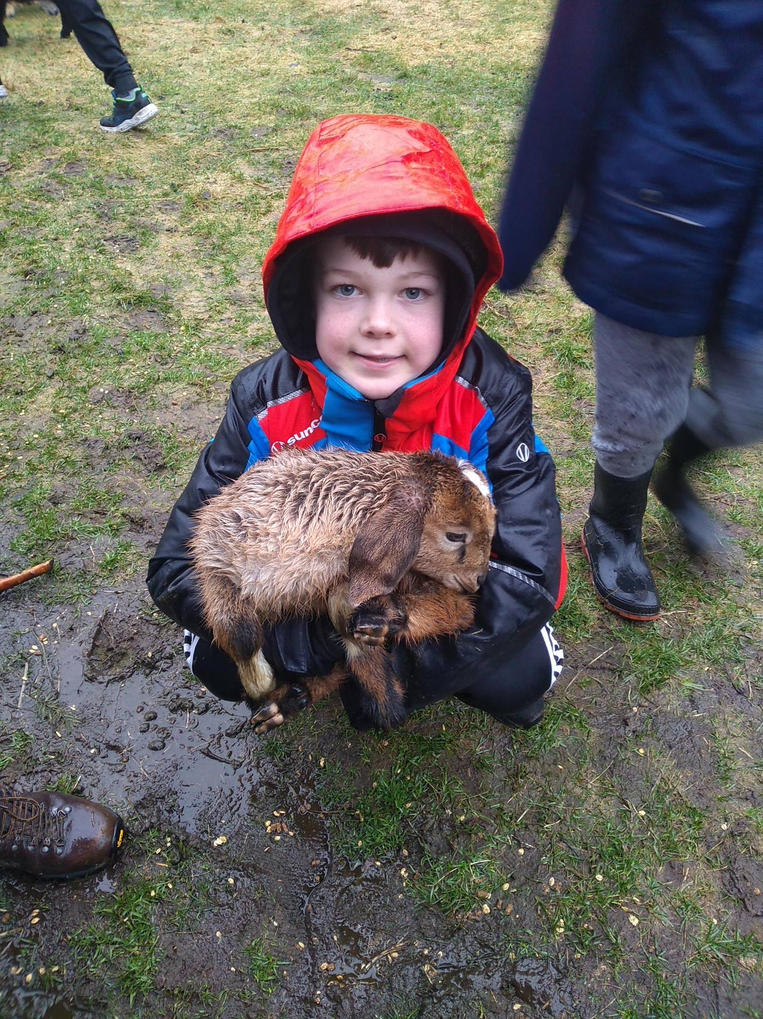

Slide 25
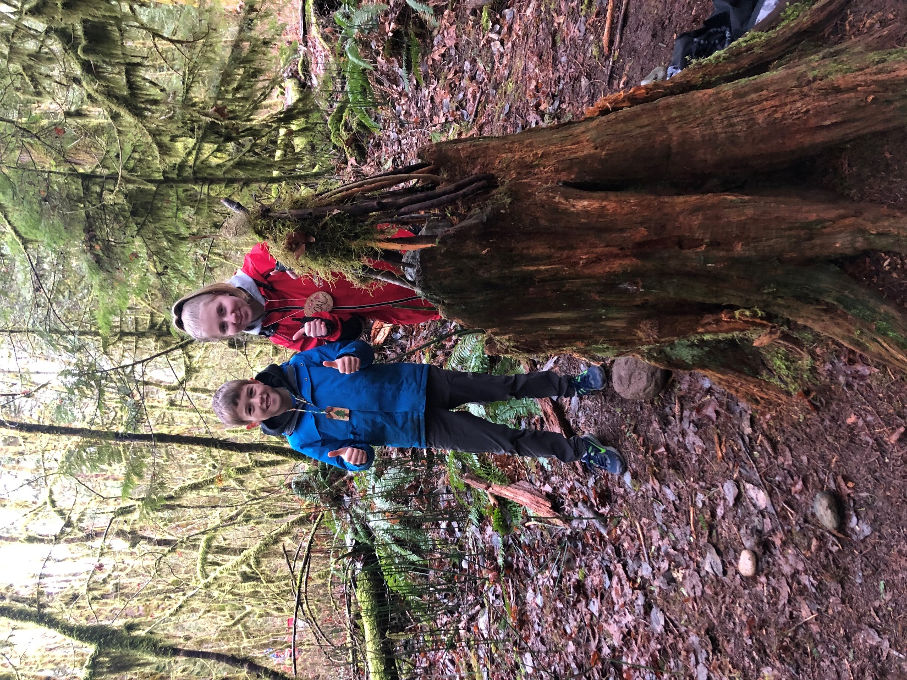

Slide 34
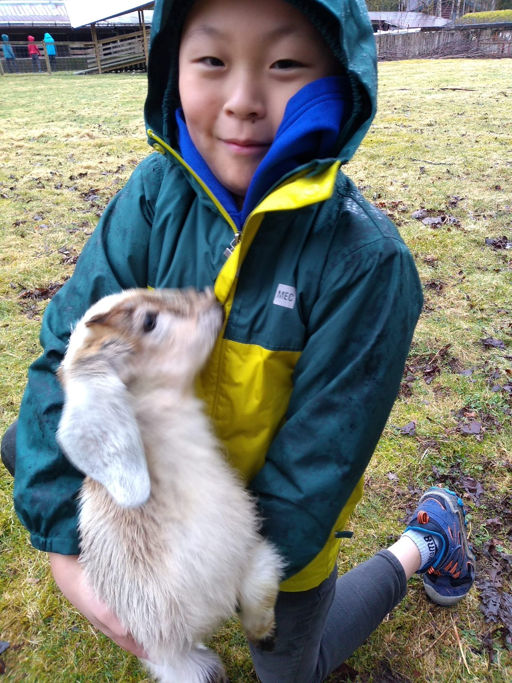

Slide 41
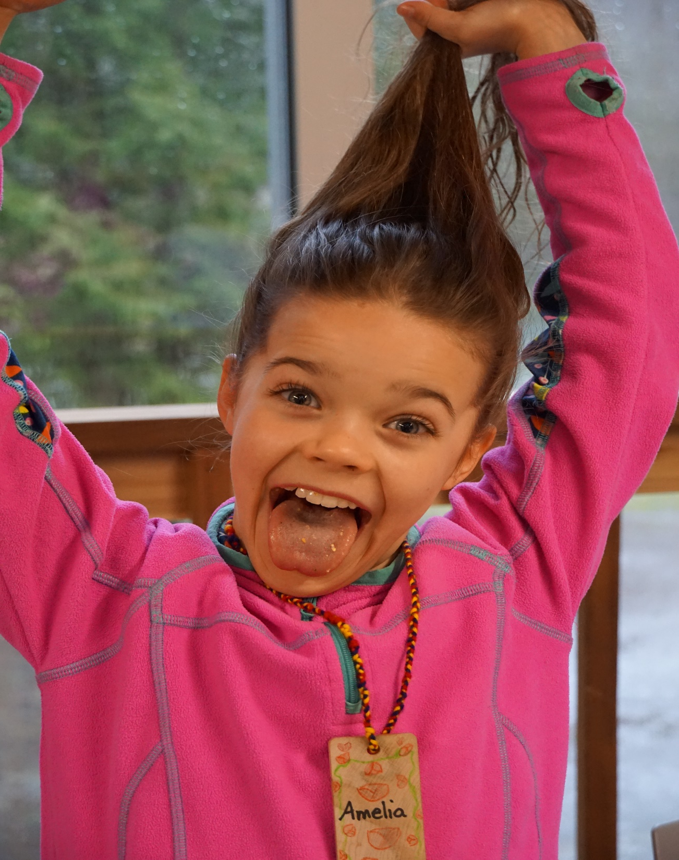

Slide 47
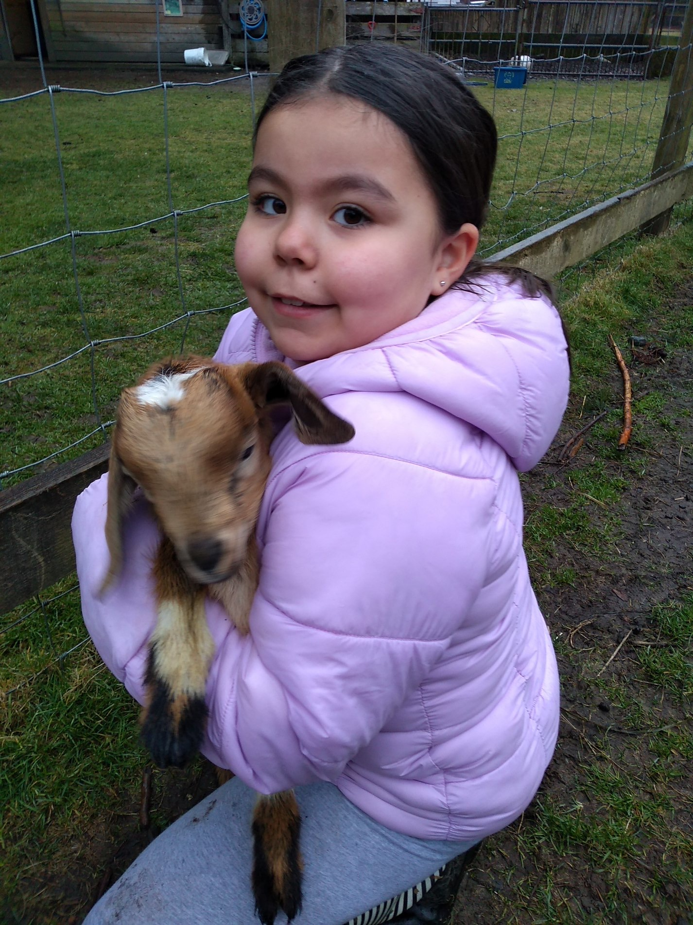

Slide 49
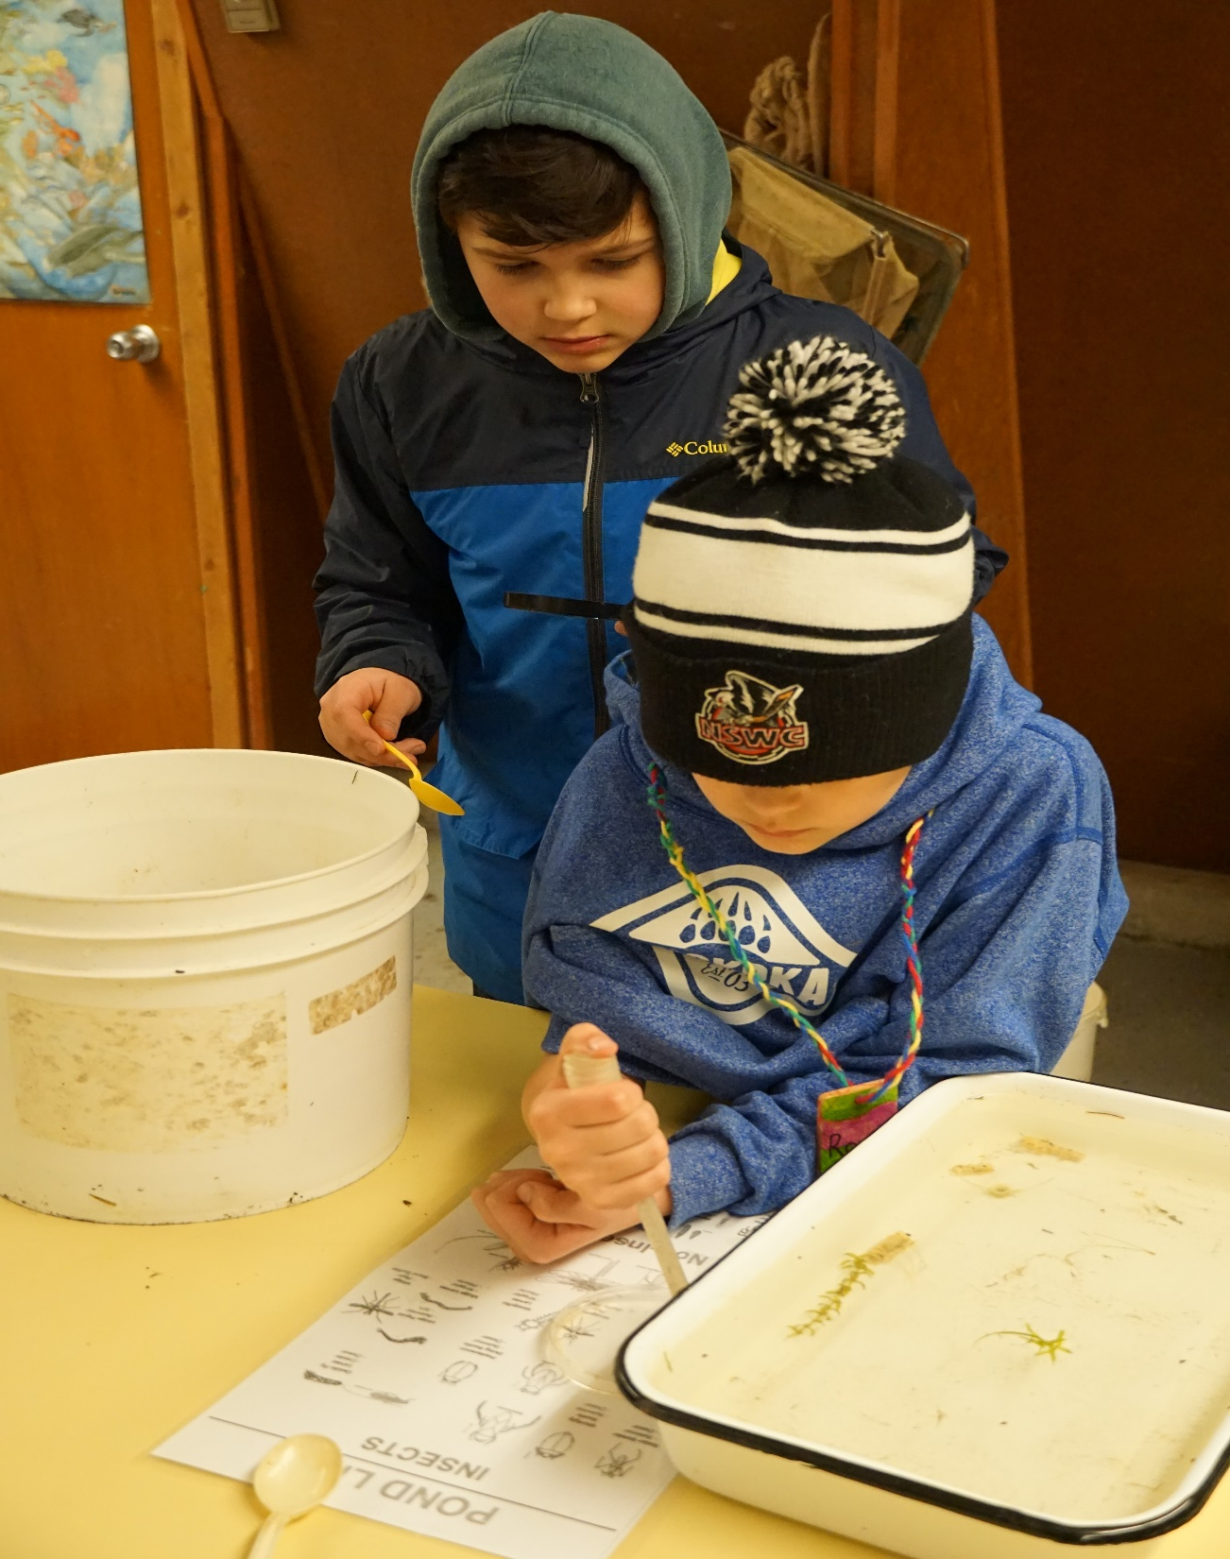

Slide 55
We’ll all miss you all ☹ <3

